Slide 1
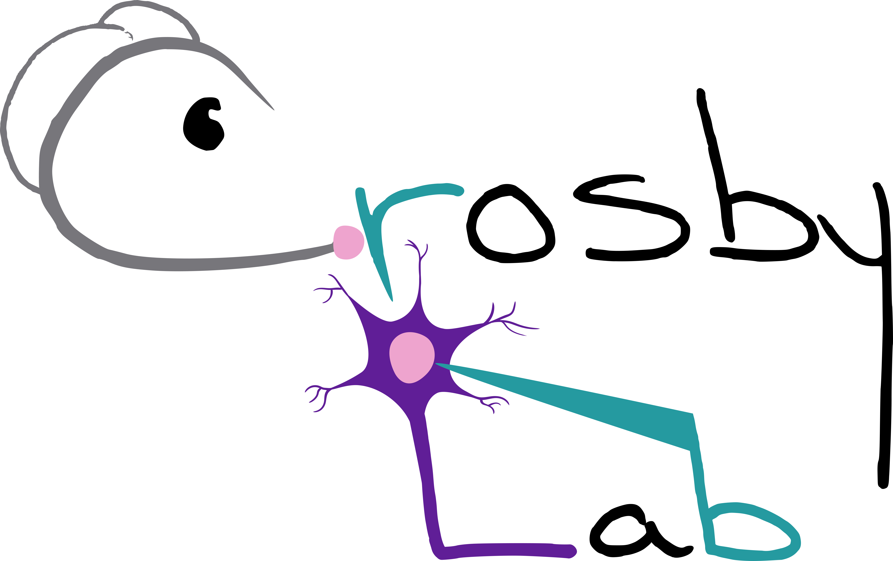


The effect of acute and repeated stress on excitatory neurons in the female rat dorsomedial hypothalamus
Ruby Muzzatti, Dr Karen Crosby
Department of Biology, Mount Allison University, Sackville, New Brunswick
Notes:
Need NBIF?

Slide 2
Background
Modern food landscape
high calorie
highly palatable
ultra-processed
High obesity rates in New Brunswick
Evidence of sex differences in food intake under chronic stress but what about acute stress?
Notes:
VERY COMPLEX but there is evidence in chronic stress, so what about acute stress, and what is the neurophysiological basis of this?

Slide 3
Hypothalamic-Pituitary-Adrenal Axis
Acute stress
Sympathetic
Nervous
System
Norepinephrine ↓ appetite
Epinephrine ↓ appetite
CRH ↓ appetite
ACTH
Cortisol ↑ appetite
Notes:
Blunted stress response

Slide 4
Hypothalamic-Pituitary-Adrenal Axis
Repeated stress
Sympathetic
Nervous
System
Norepinephrine ↓ appetite
Epinephrine ↓ appetite
CRH ↓ appetite
ACTH
Increases consumption of highly palatable “comfort foods”
Cortisol ↑ appetite
Risk factors for increased food intake under chronic stress in humans include being female, overweight, or having a history of food restriction
Notes:
Blunted negative feedback response
In additional to weakening your immune system…

Slide 5
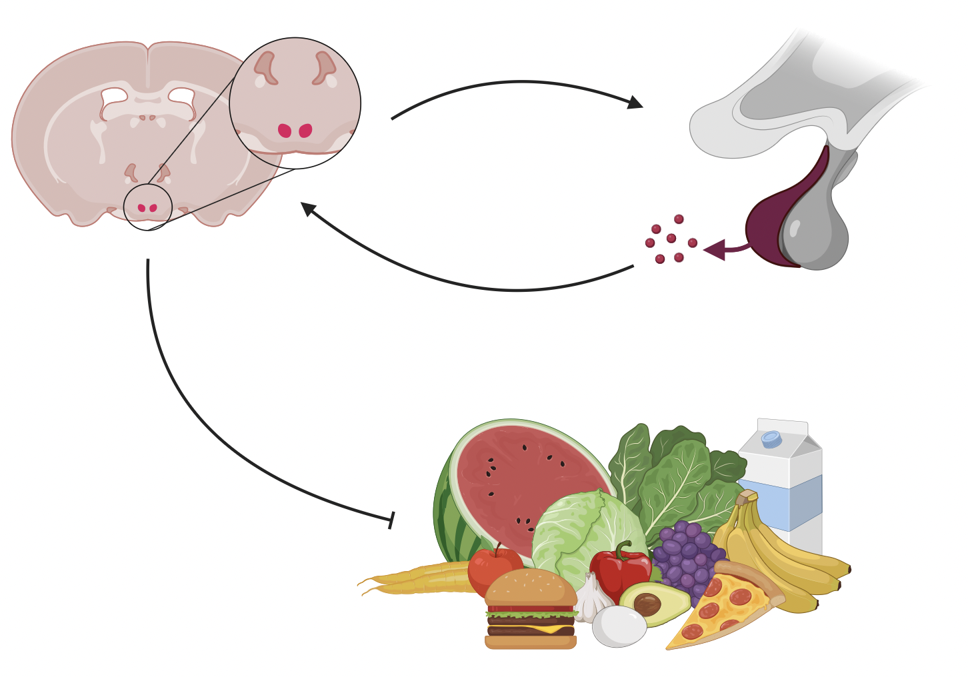
Why study the DMH?
Notes:
The DMH is involved in a lot of processes, including regulation of heart rate during stress, thermoregulation, and super importantly the regulation of appetite and body weight
Remember those glucocorticoid receptors?

Slide 6
Why study the DMH?
Notes:
The DMH is involved in a lot of processes, including regulation of heart rate during stress, thermoregulation, and super importantly the regulation of appetite and body weight
Remember those glucocorticoid receptors?

Slide 7
Why study the DMH?
Notes:
The DMH is involved in a lot of processes, including regulation of heart rate during stress, thermoregulation, and super importantly the regulation of appetite and body weight
Remember those glucocorticoid receptors?

Slide 8
Why study the DMH?
Notes:
The DMH is involved in a lot of processes, including regulation of heart rate during stress, thermoregulation, and super importantly the regulation of appetite and body weight
Remember those glucocorticoid receptors?

Slide 9
Does acute stress and repeated stress affect glutamate transmission in DMH neurons of young female rats? If so, by what mechanism?
Notes:
Hypothesis: acute stress will alter neuronal excitability and communication in the DMH
Prediction: acute stress will decrease transmission of glutamate and activity of DMH neurons

Slide 10

Presynaptic neuron
Nervous System Basics
Postsynaptic neuron
Notes:
The nervous system uses chemical (neurotransmitter) and electrical signals to communicate
Electrical stimulation comes down, NT releases from the presynaptic neuron into the synaptic cleft, and then those NT make the postsynaptic neuron more or less likely to fire an action potential for this to continue

Slide 11
Presynaptic neuron
Nervous System Basics
Electrical
Postsynaptic neuron
Notes:
The nervous system uses chemical (neurotransmitter) and electrical signals to communicate
Electrical stimulation comes down, NT releases from the presynaptic neuron into the synaptic cleft, and then those NT make the postsynaptic neuron more or less likely to fire an action potential for this to continue

Slide 12
Presynaptic neuron
Nervous System Basics
Electrical
Neurotransmitter
Synapse
Postsynaptic neuron
Notes:
The nervous system uses chemical (neurotransmitter) and electrical signals to communicate
Electrical stimulation comes down, NT releases from the presynaptic neuron into the synaptic cleft, and then those NT make the postsynaptic neuron more or less likely to fire an action potential for this to continue

Slide 13
Presynaptic neuron
Nervous System Basics
Electrical
Neurotransmitter
Synapse
Postsynaptic neuron
Notes:
The nervous system uses chemical (neurotransmitter) and electrical signals to communicate
Electrical stimulation comes down, NT releases from the presynaptic neuron into the synaptic cleft, and then those NT make the postsynaptic neuron more or less likely to fire an action potential for this to continue

Slide 14
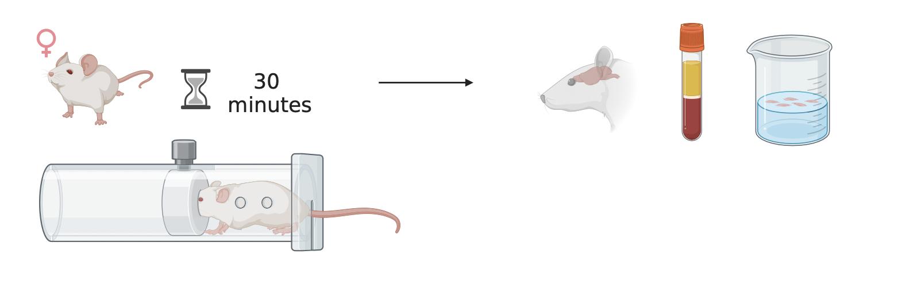
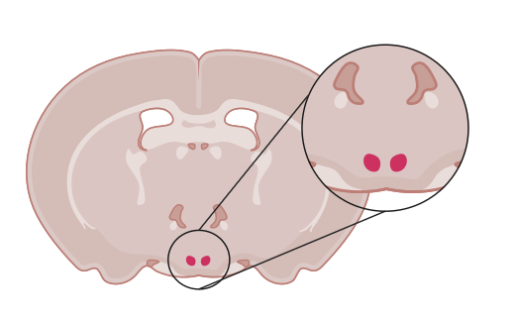
Methods: Stress
Single restraint for acute
5 consecutive days for repeated

Slide 15
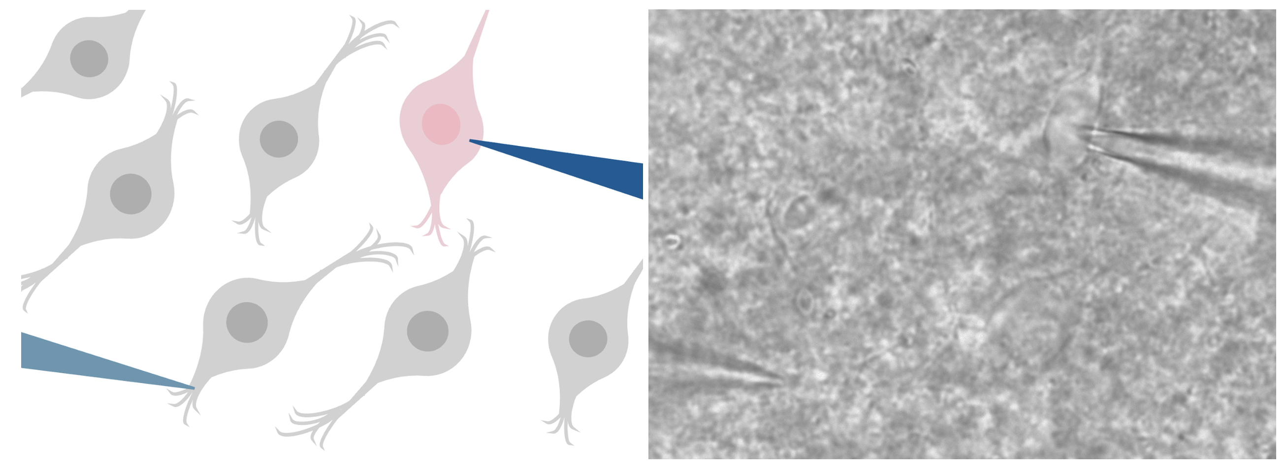
Methods: Recording from living neurons
Postsynaptic neuron
Presynaptic neuron

Slide 16
Methods: Recording from living neurons
Amplitude (pA)
Peak 1
Peak 2
Time (msec)

Slide 17
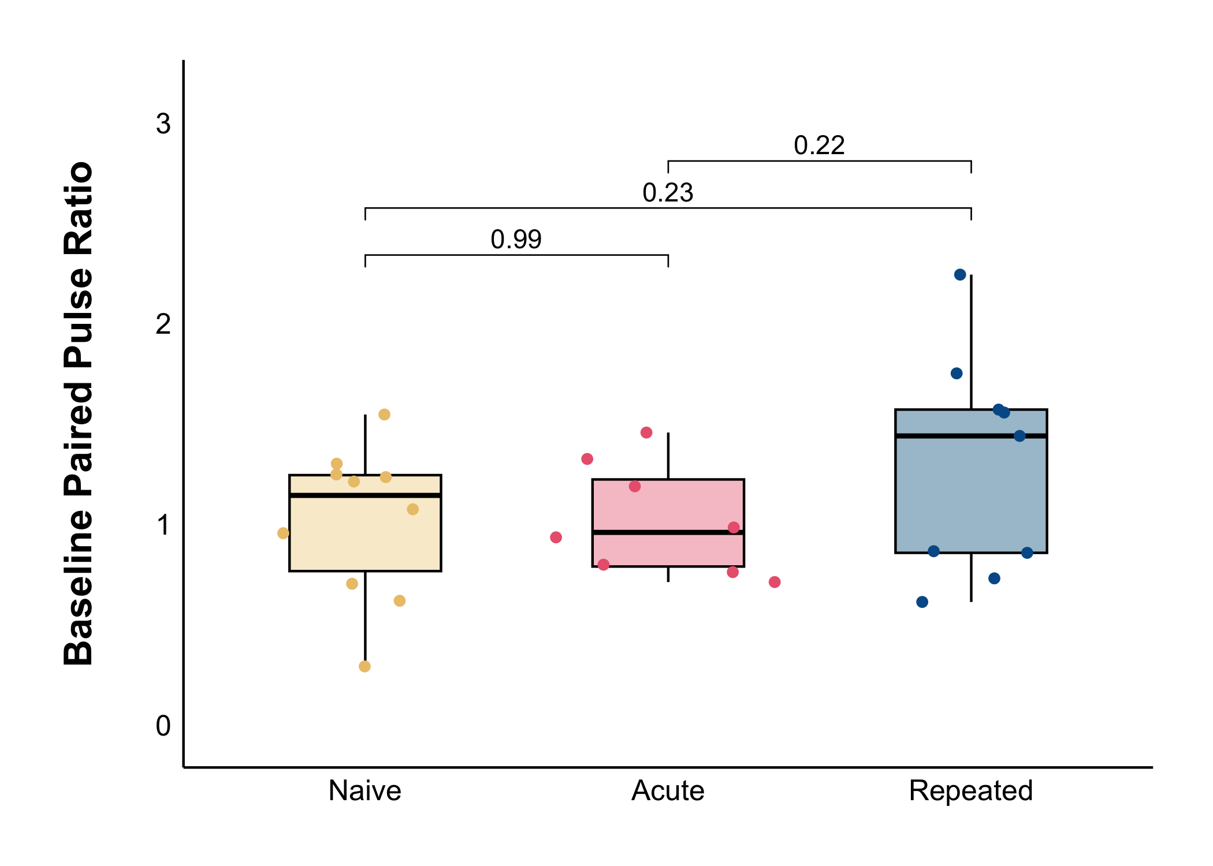
Baseline Results
No change in PPR
PPR = P2/P1
No change in presynaptic probability of glutamate release

Slide 18
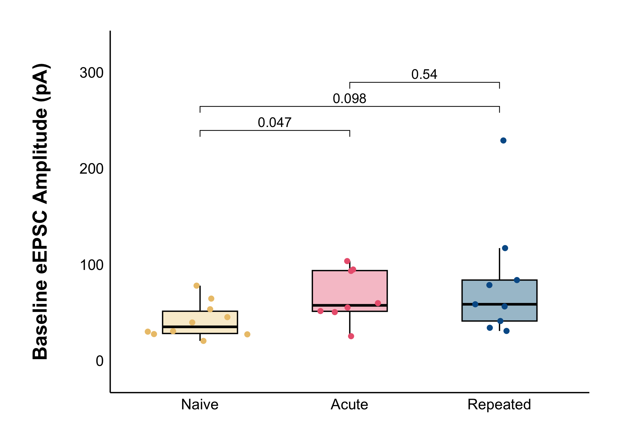
Baseline Results
Increased eEPSC amplitude under acute stress (*)
No change under repeated stress
No difference between acute and repeated stress

Slide 19
What about long-lasting changes?

Slide 20
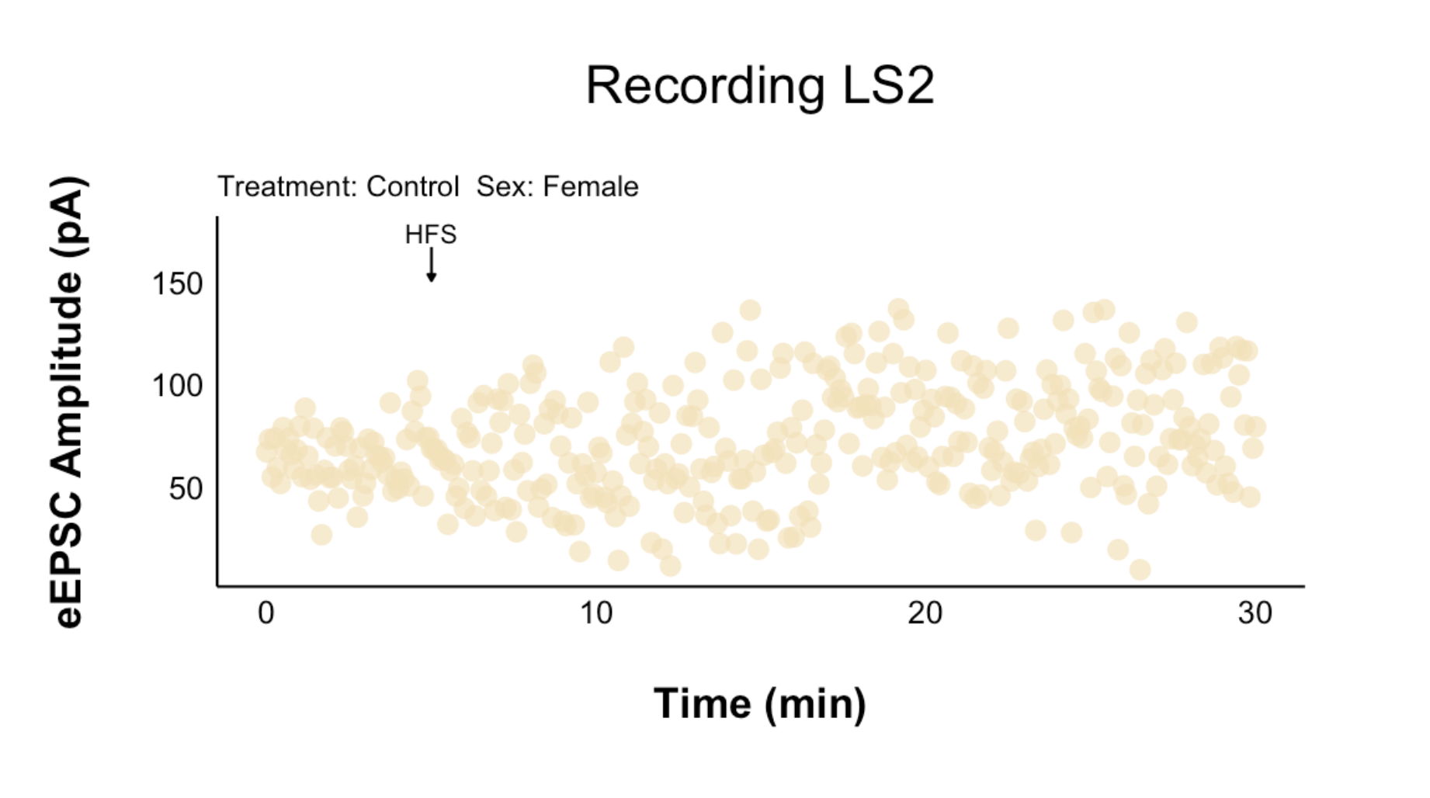
12 peaks per minute

Slide 21
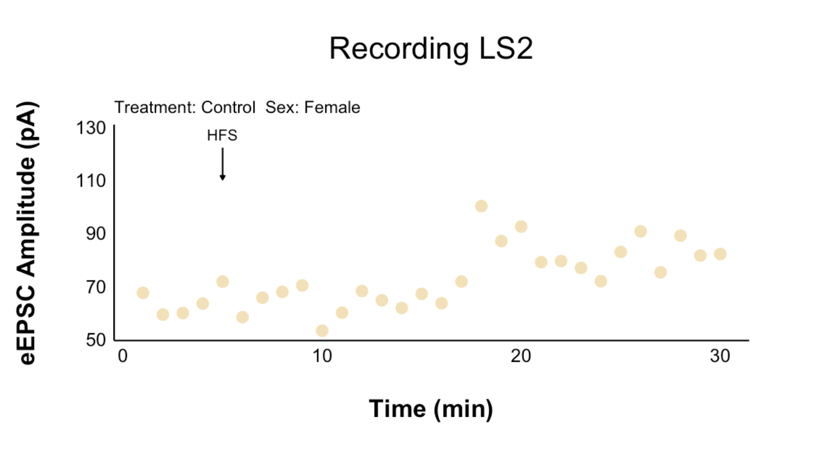
12 peaks per minute are averaged per minute

Slide 22
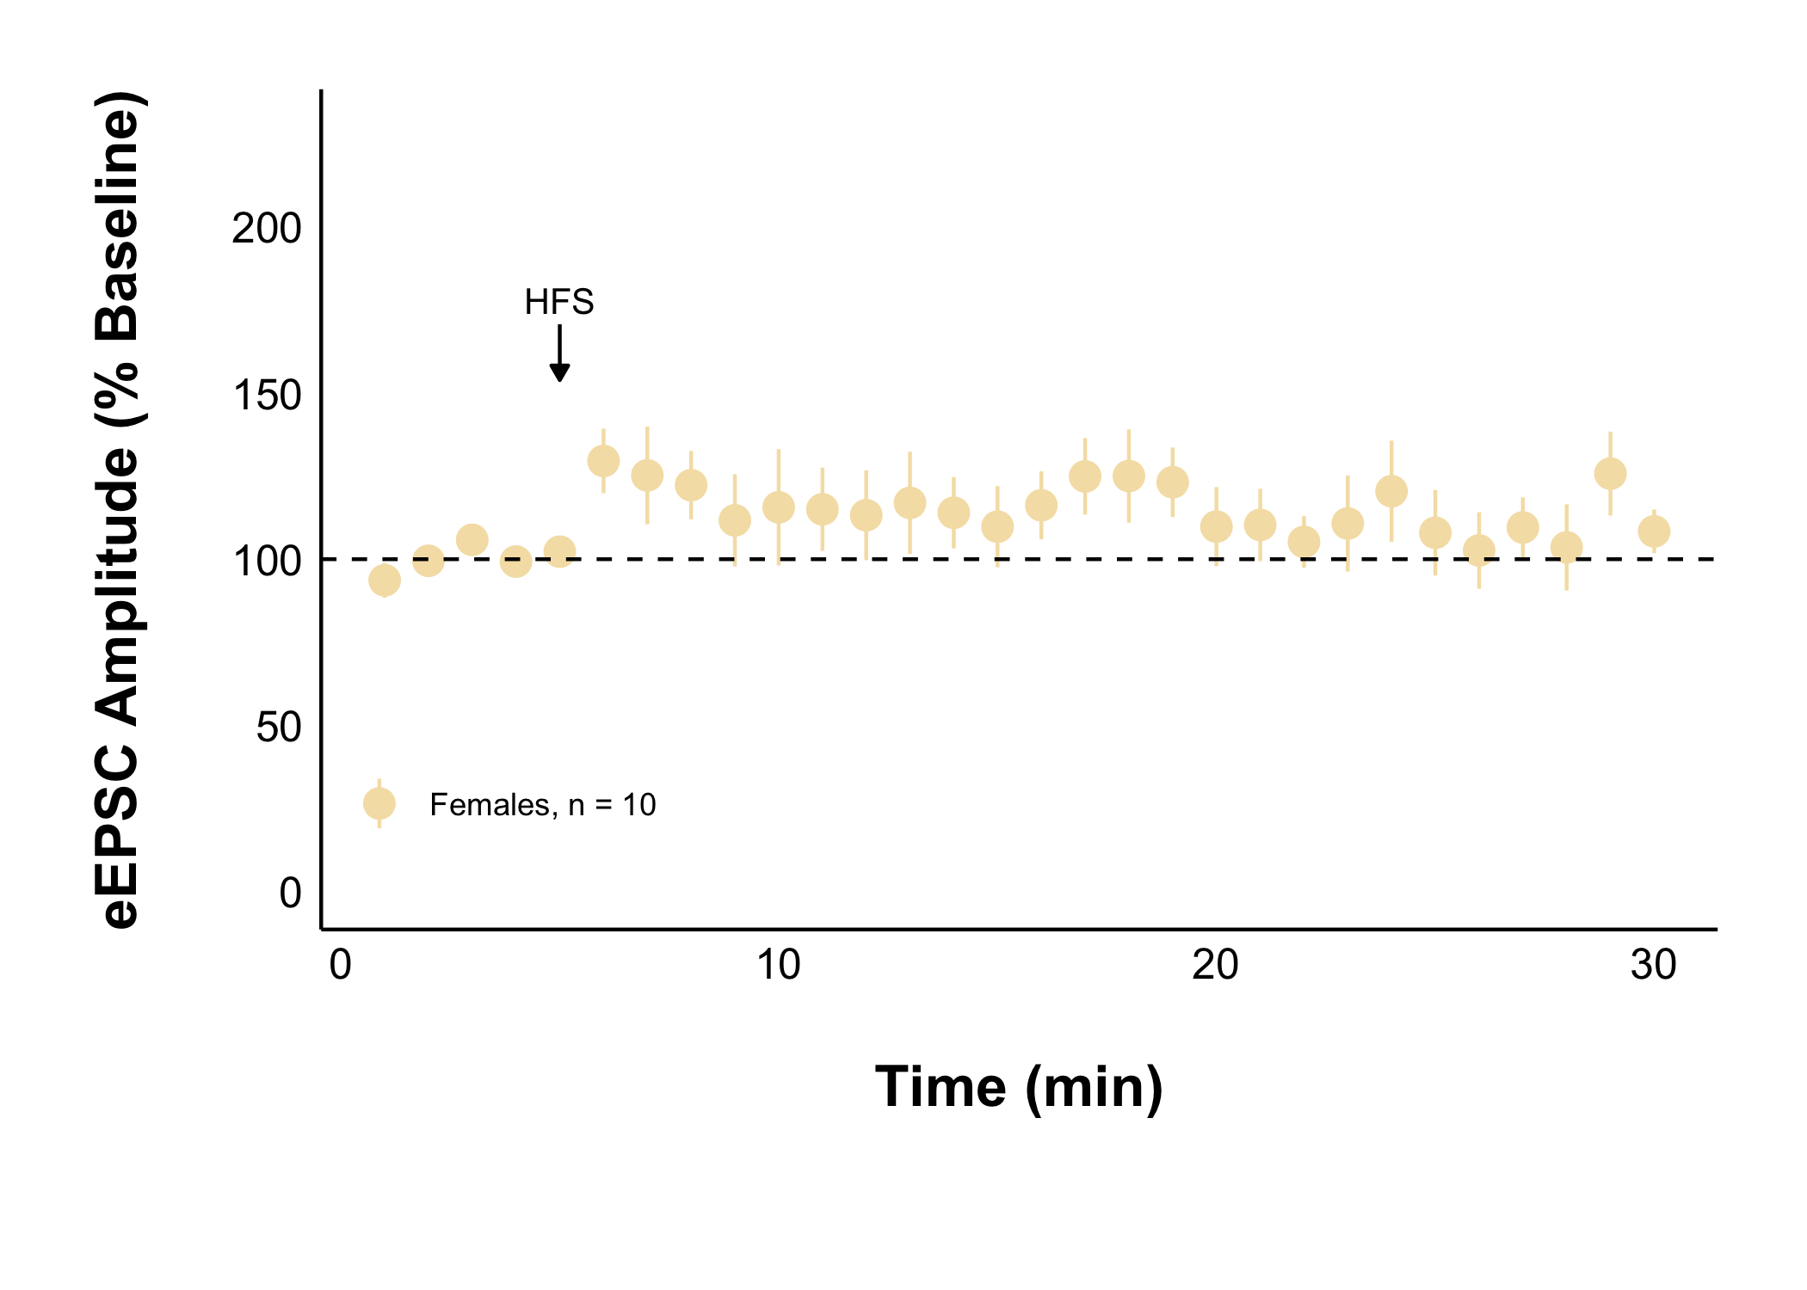
Cells are averaged and presented with SE

Slide 23
Amplitude is normalized to the 5-minute baseline period

Slide 24
High Frequency Stimulation: 100 Hz for 4 seconds, twice, 20 seconds apart
Allows for observation of long-lasting changes

Slide 25
There is no long-lasting eEPSC amplitude change in naive females

Slide 26
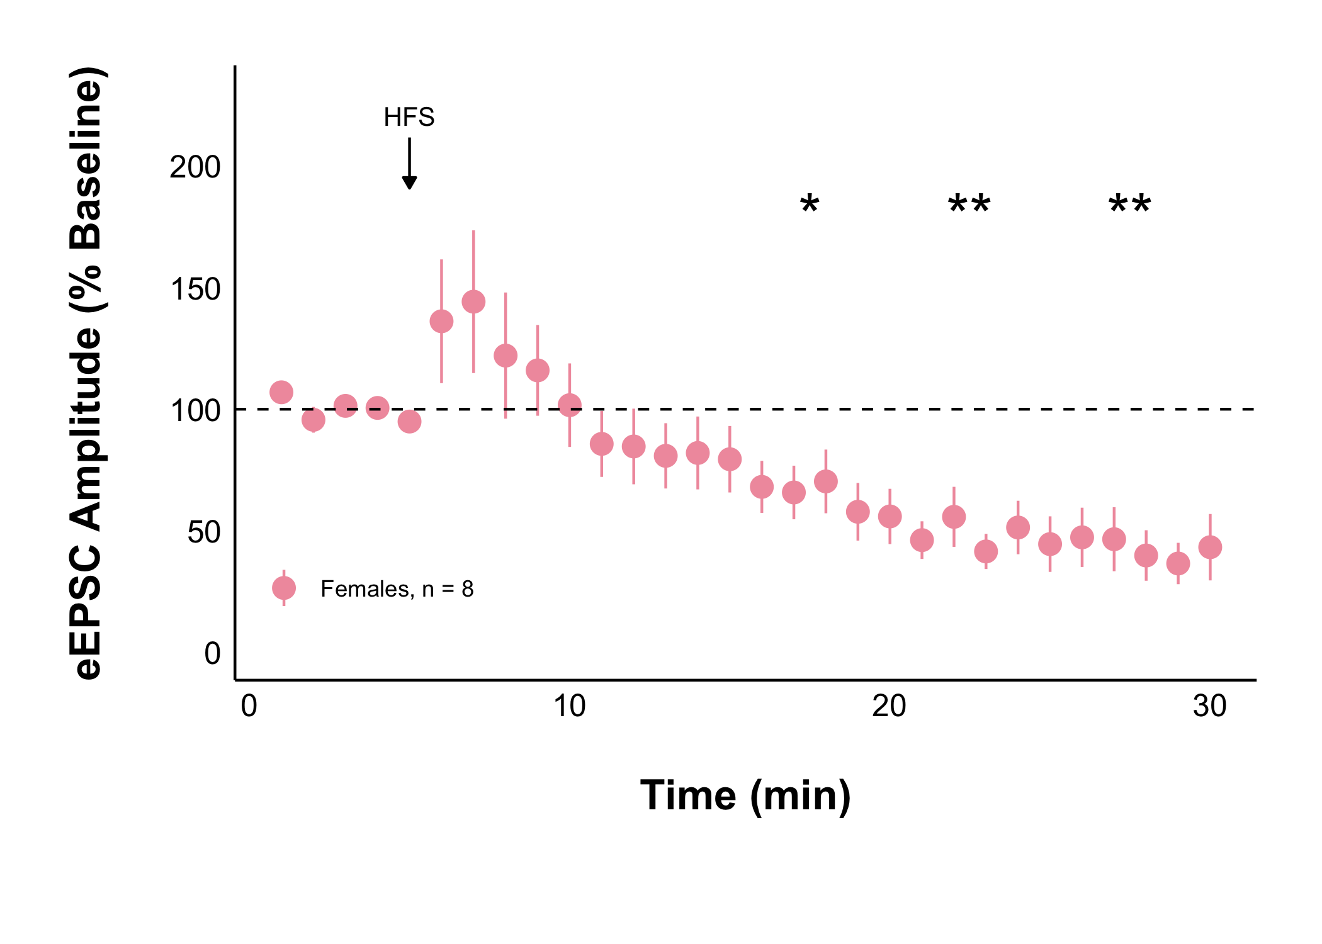
Naïve + Control Treatment
Acute Stress + Control Treatment
Acute stress decreases evoked excitatory current amplitude after HFS

Slide 27
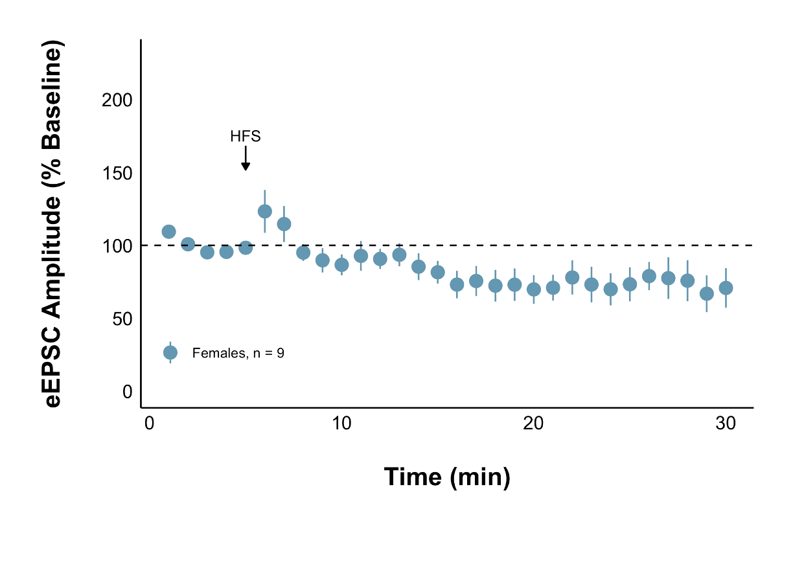
Naïve + Control Treatment
Repeated Stress + Control Treatment
Repeated stress does not significantly change evoked excitatory current amplitude after HFS

Slide 28
Why does acute stress decrease the strength of glutamate synapses?

Slide 29
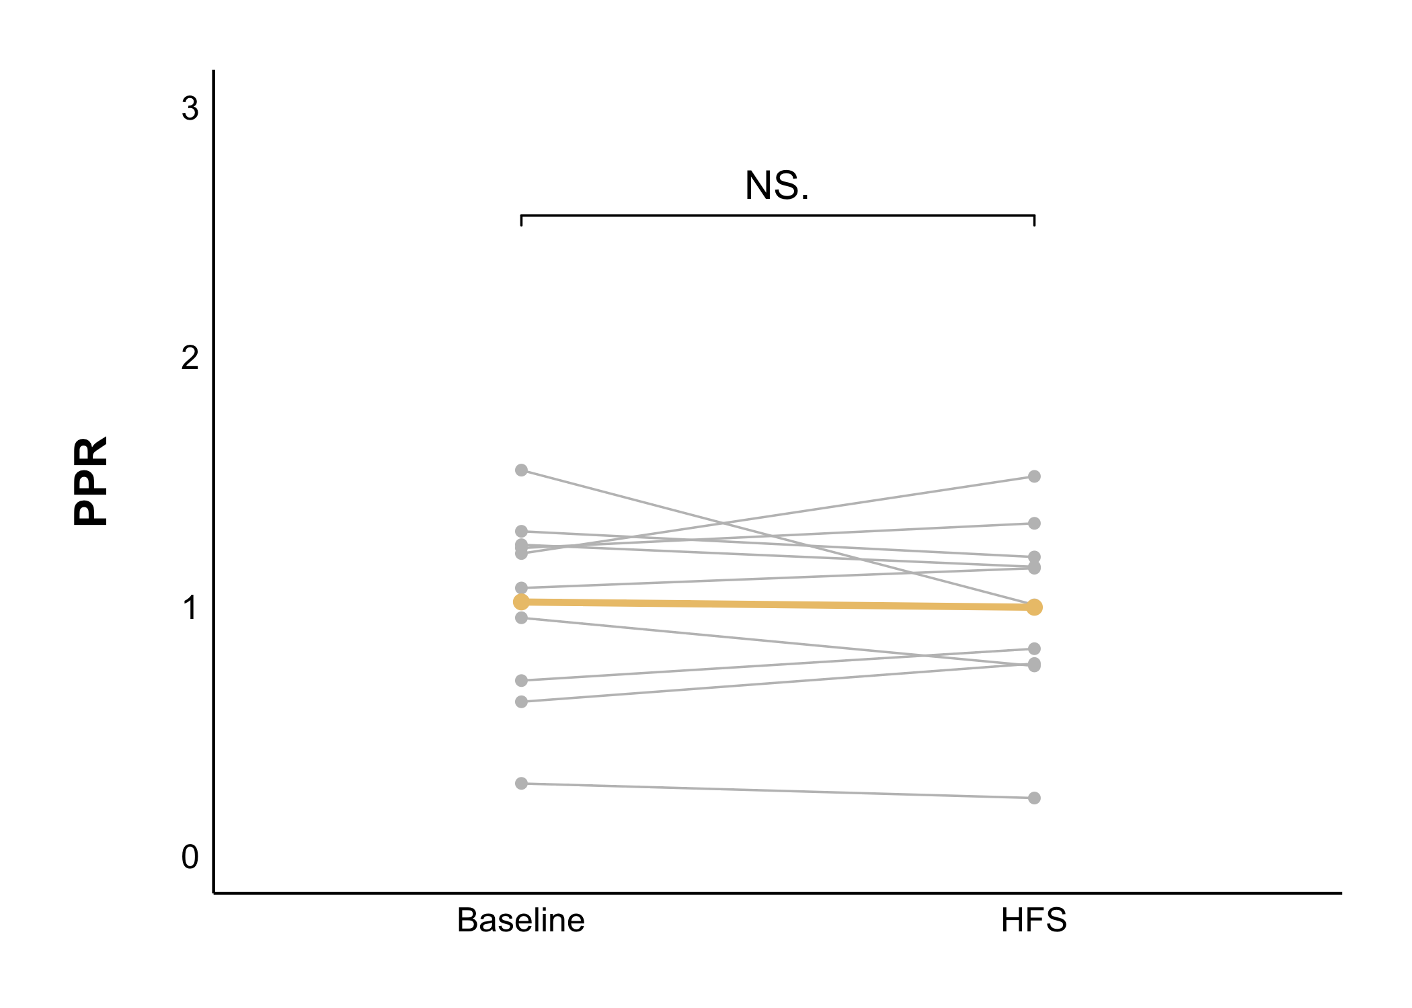
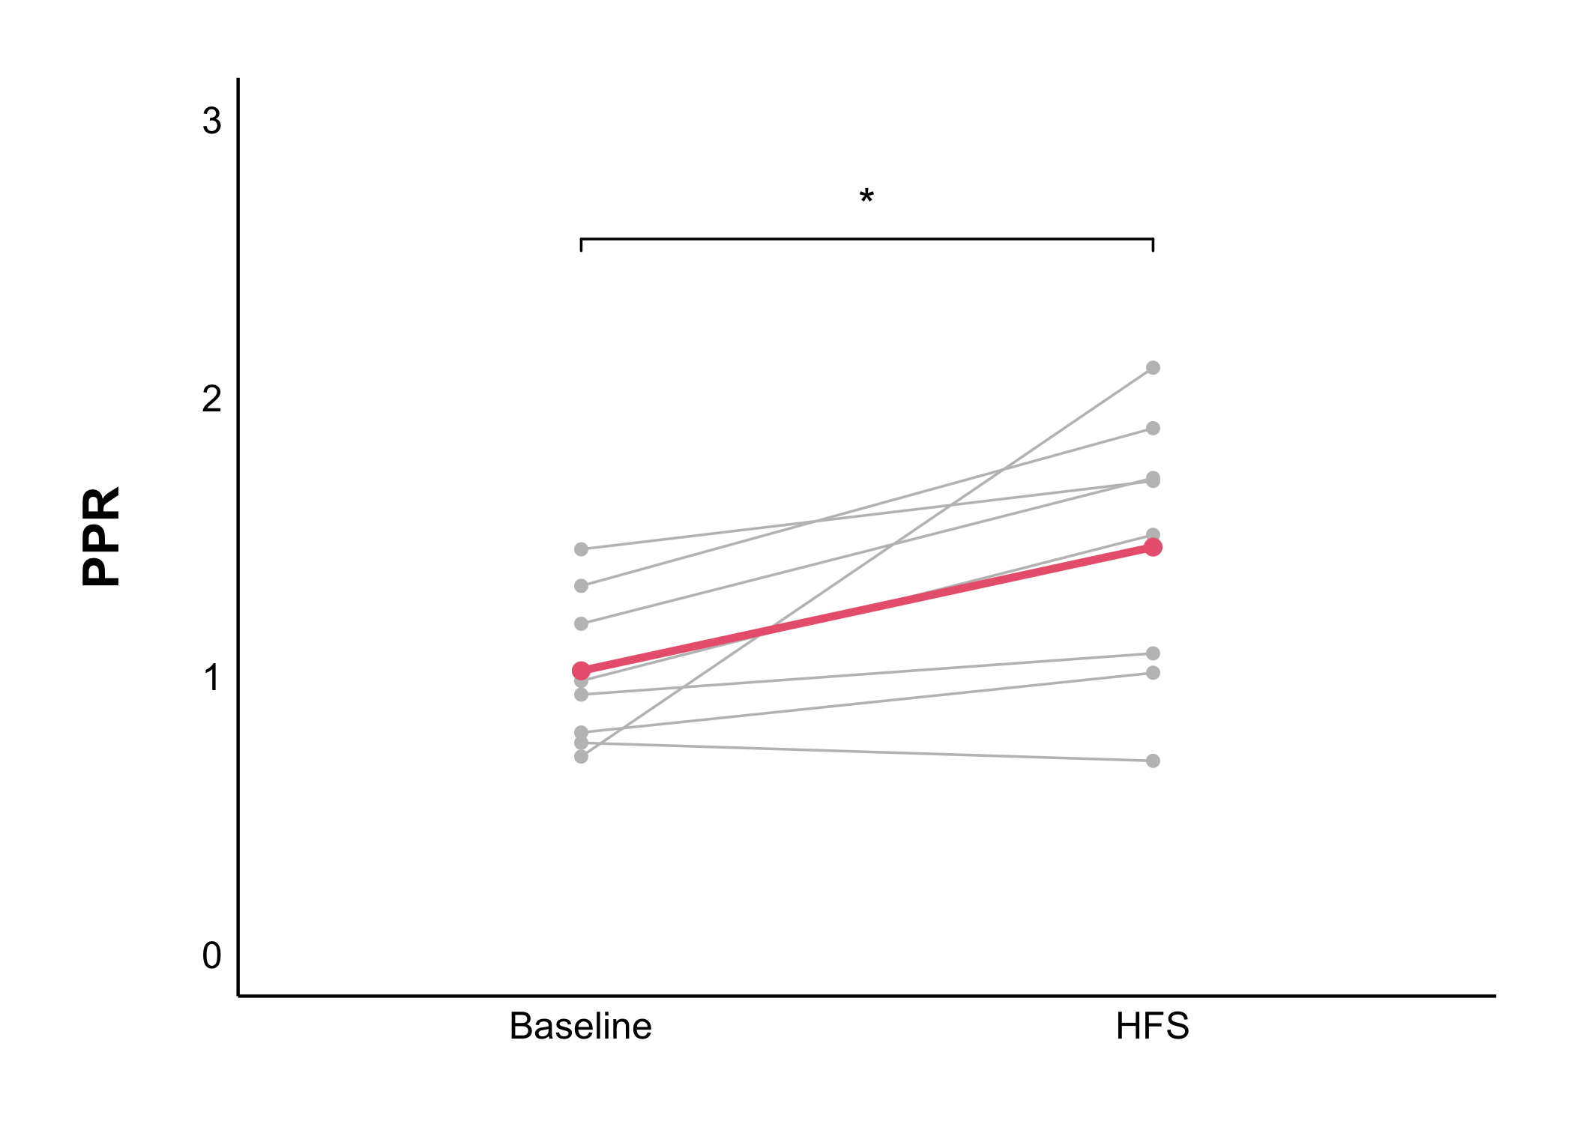
Naïve + Control Treatment
Acute Stress + Control Treatment
Acute stress presynaptically decreases the probability of presynaptic glutamate release after HFS
Notes:
YES

Slide 30
What is causing the presynaptic decrease in glutamate transmission seen under acute stress?

Slide 31
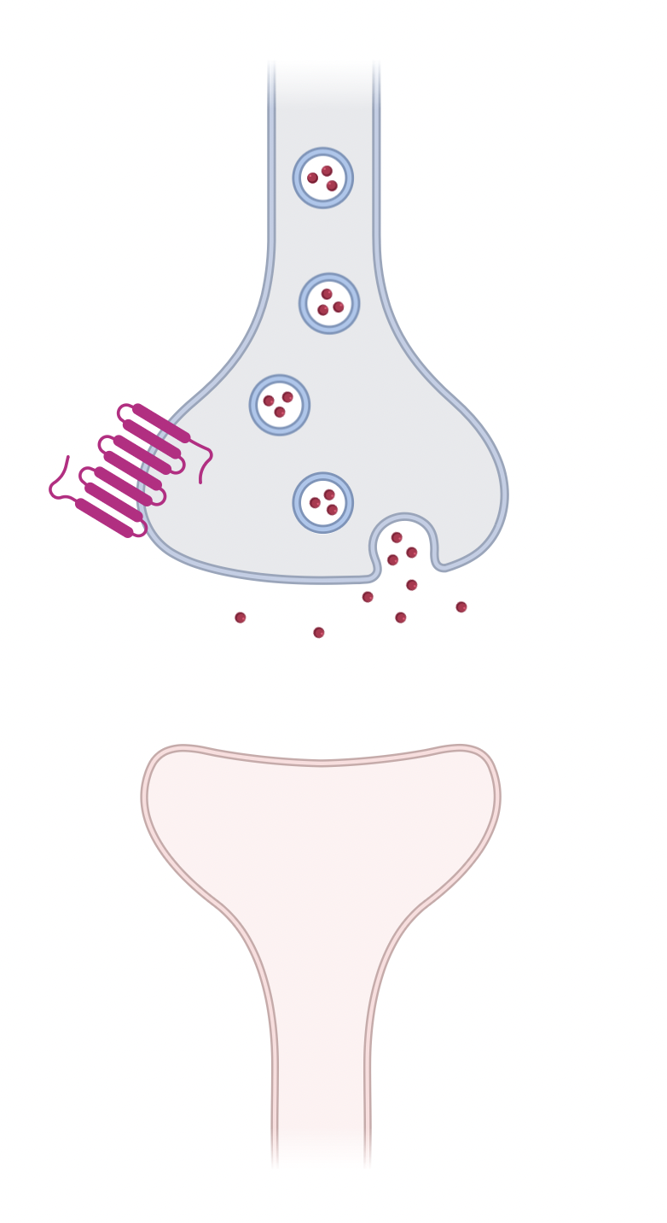
Notes:
RETROGRADE SIGNALLING
THIS IS WHAT NORMALLY HAPPENS AS PART OF CORTISOL’S NEGATIVE FEEDBACK
We know this happens in CRH neurons in the PVN
Is this what is happening in our DMH neurons?

Slide 32
1. Cortisol binds to glucocorticoid receptors
Notes:
RETROGRADE SIGNALLING
THIS IS WHAT NORMALLY HAPPENS AS PART OF CORTISOL’S NEGATIVE FEEDBACK
We know this happens in CRH neurons in the PVN
Is this what is happening in our DMH neurons?

Slide 33
2. Endocannabinoid (eCB) synthesis increases
1. Cortisol binds to glucocorticoid receptors
Notes:
RETROGRADE SIGNALLING
THIS IS WHAT NORMALLY HAPPENS AS PART OF CORTISOL’S NEGATIVE FEEDBACK
We know this happens in CRH neurons in the PVN
Is this what is happening in our DMH neurons?

Slide 34
3. eCBs travel backwards and activate CB1Rs
2. Endocannabinoid (eCB) synthesis increases
1. Cortisol binds to glucocorticoid receptors
Notes:
RETROGRADE SIGNALLING
THIS IS WHAT NORMALLY HAPPENS AS PART OF CORTISOL’S NEGATIVE FEEDBACK
We know this happens in CRH neurons in the PVN
Is this what is happening in our DMH neurons?

Slide 35
4. Activation of CB1Rs inhibits glutamate release
3. eCBs travel backwards and activate CB1Rs
2. Endocannabinoid (eCB) synthesis increases
1. Cortisol binds to glucocorticoid receptors
Notes:
RETROGRADE SIGNALLING
THIS IS WHAT NORMALLY HAPPENS AS PART OF CORTISOL’S NEGATIVE FEEDBACK
We know this happens in CRH neurons in the PVN
Is this what is happening in our DMH neurons?

Slide 36
4. Activation of CB1Rs inhibits glutamate release
3. eCBs travel backwards and activate CB1Rs
2. Endocannabinoid (eCB) synthesis increases
1. Cortisol binds to glucocorticoid receptors
Notes:
RETROGRADE SIGNALLING
THIS IS WHAT NORMALLY HAPPENS AS PART OF CORTISOL’S NEGATIVE FEEDBACK
We know this happens in CRH neurons in the PVN
Is this what is happening in our DMH neurons?

Slide 37
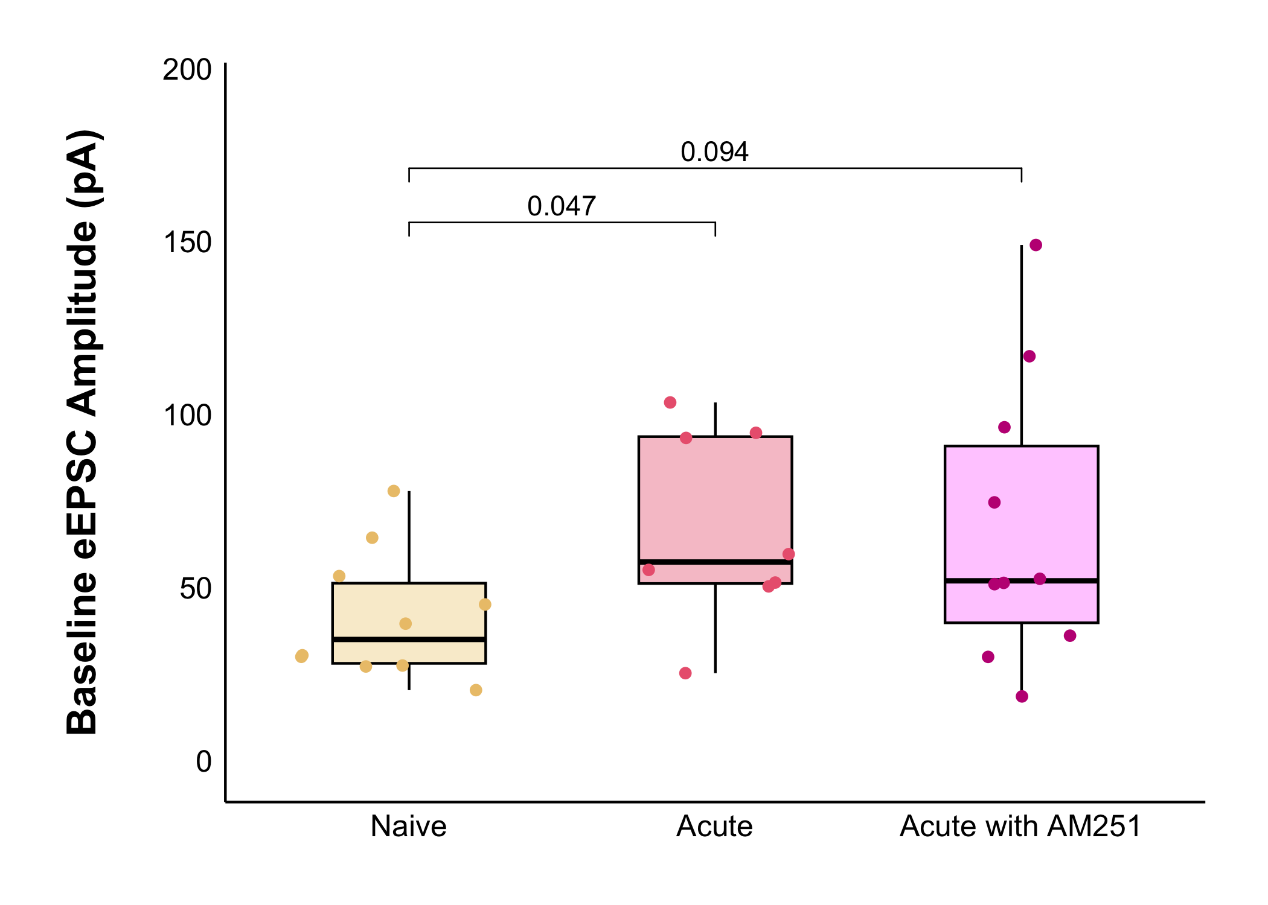
Baseline Results
There is no longer a significant increase in baseline eEPSC amplitude under acute stress with 5uM of AM251 applied to block CB1 receptors
Notes:
Remember there was no difference in PPR between acute and naïve so we don’t really care now if AM251 changes it (but it doesn't)

Slide 38
What about long-lasting changes?

Slide 39
Naïve + Control Treatment
Acute Stress + Control Treatment
Acute stress decreases evoked excitatory current amplitude after HFS
Notes:
REMINDER

Slide 40
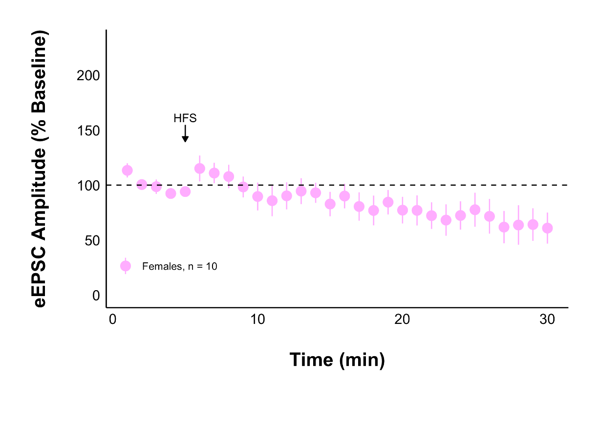
Acute Stress + AM251
Acute Stress + Control Treatment
Glutamate transmission did not decrease when CB1Rs were blocked

Slide 41
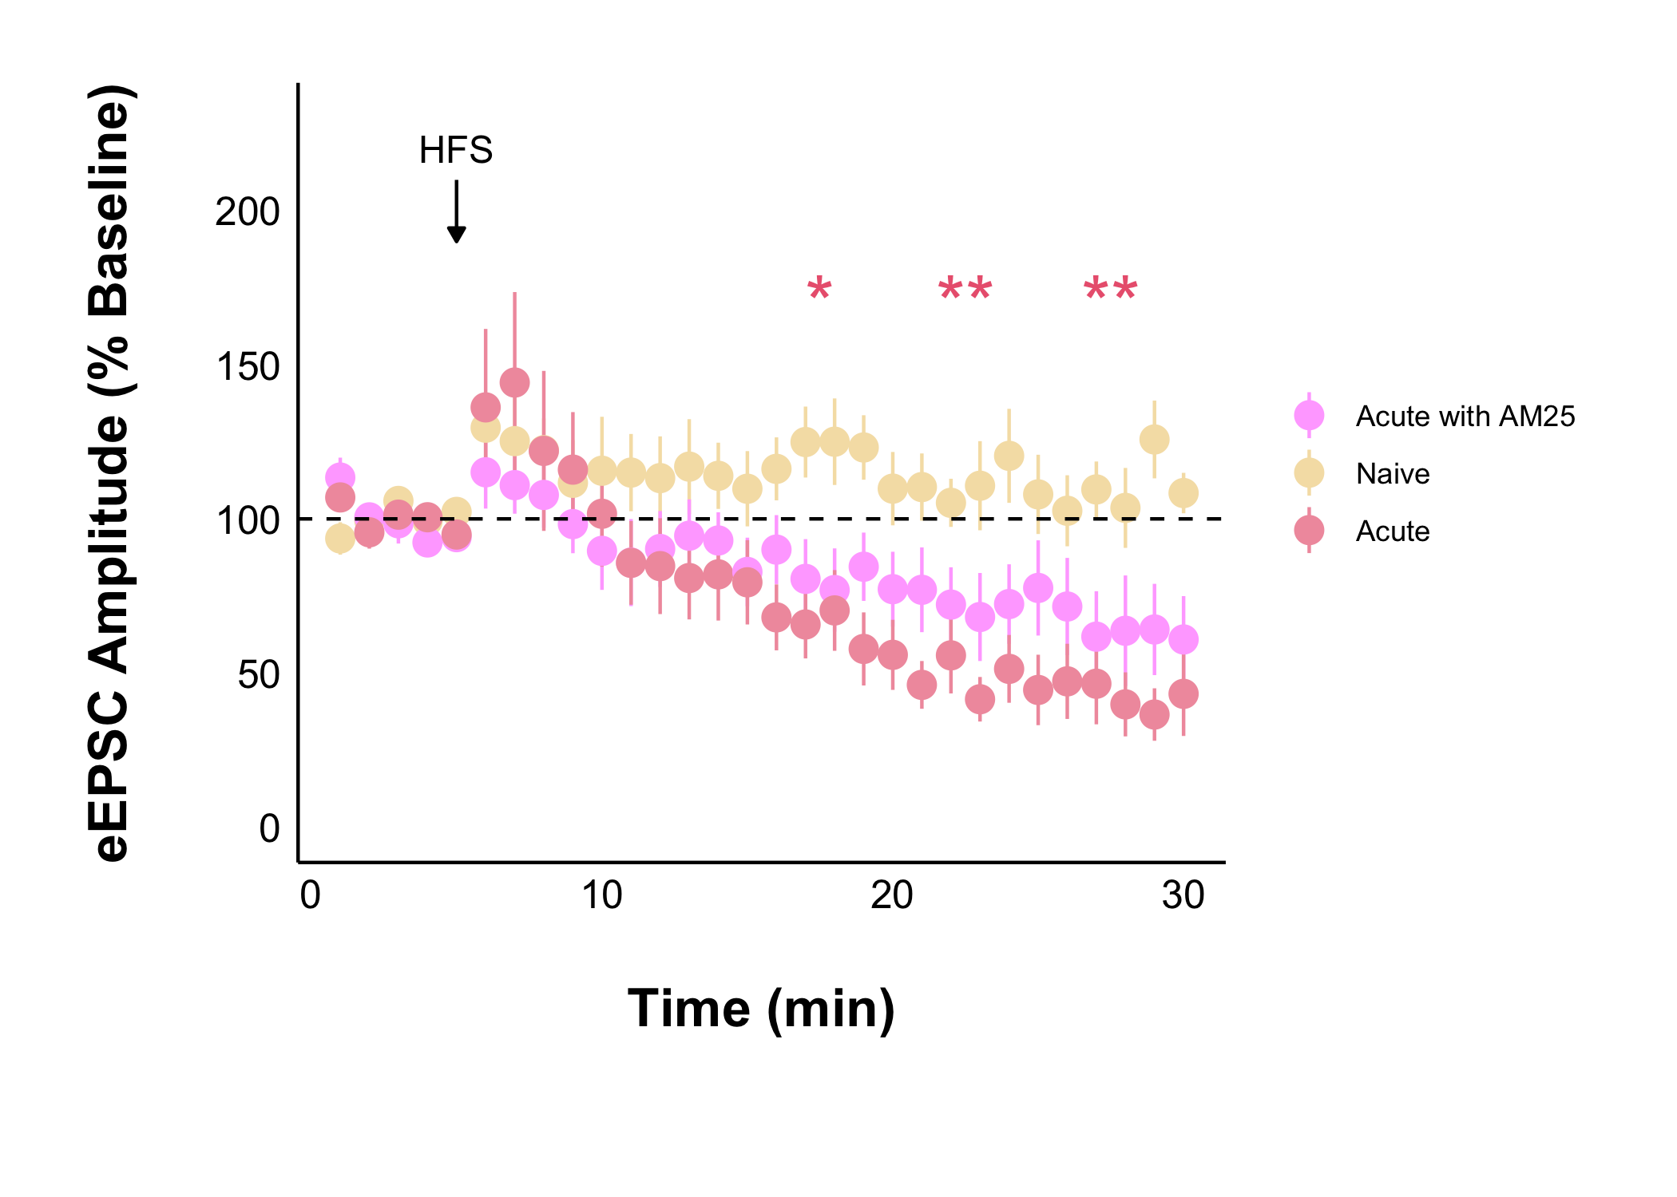

Slide 42
Is this no change in acute stress with AM251 related to presynaptic glutamate release probability like the decrease with acute stress was?

Slide 43
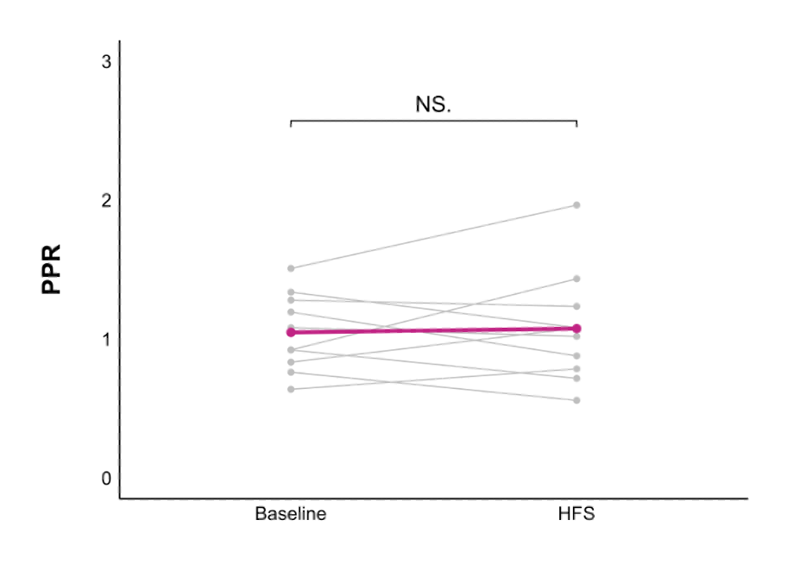
Acute Stress + AM251
Acute Stress + Control Treatment
The decrease in presynaptic glutamate release was not seen when CB1Rs were blocked
Notes:
YES

Slide 44
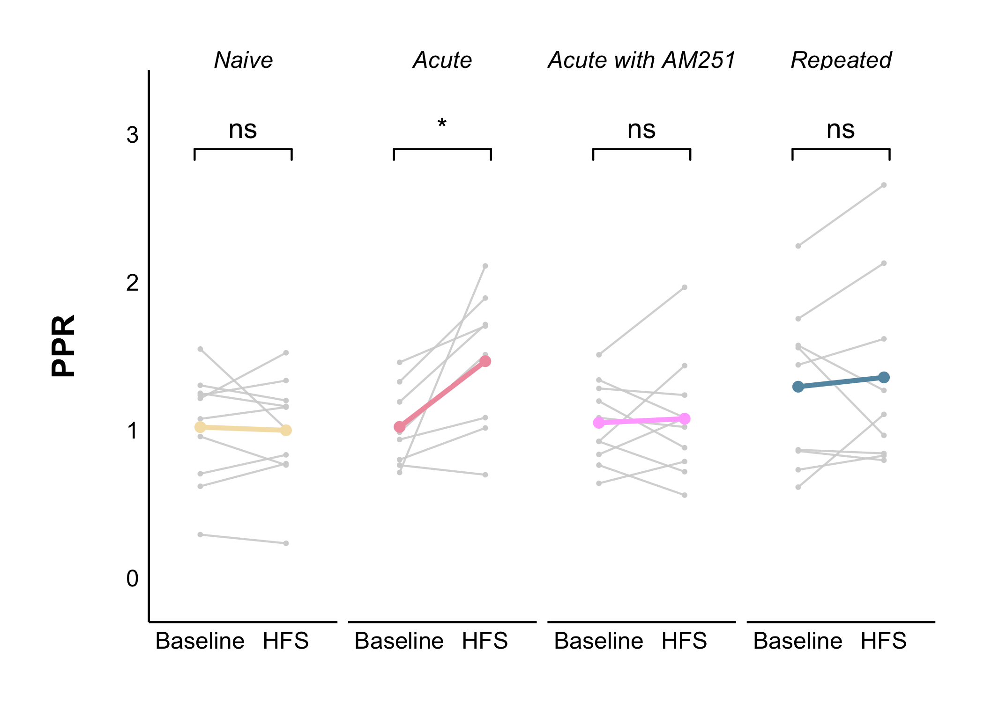
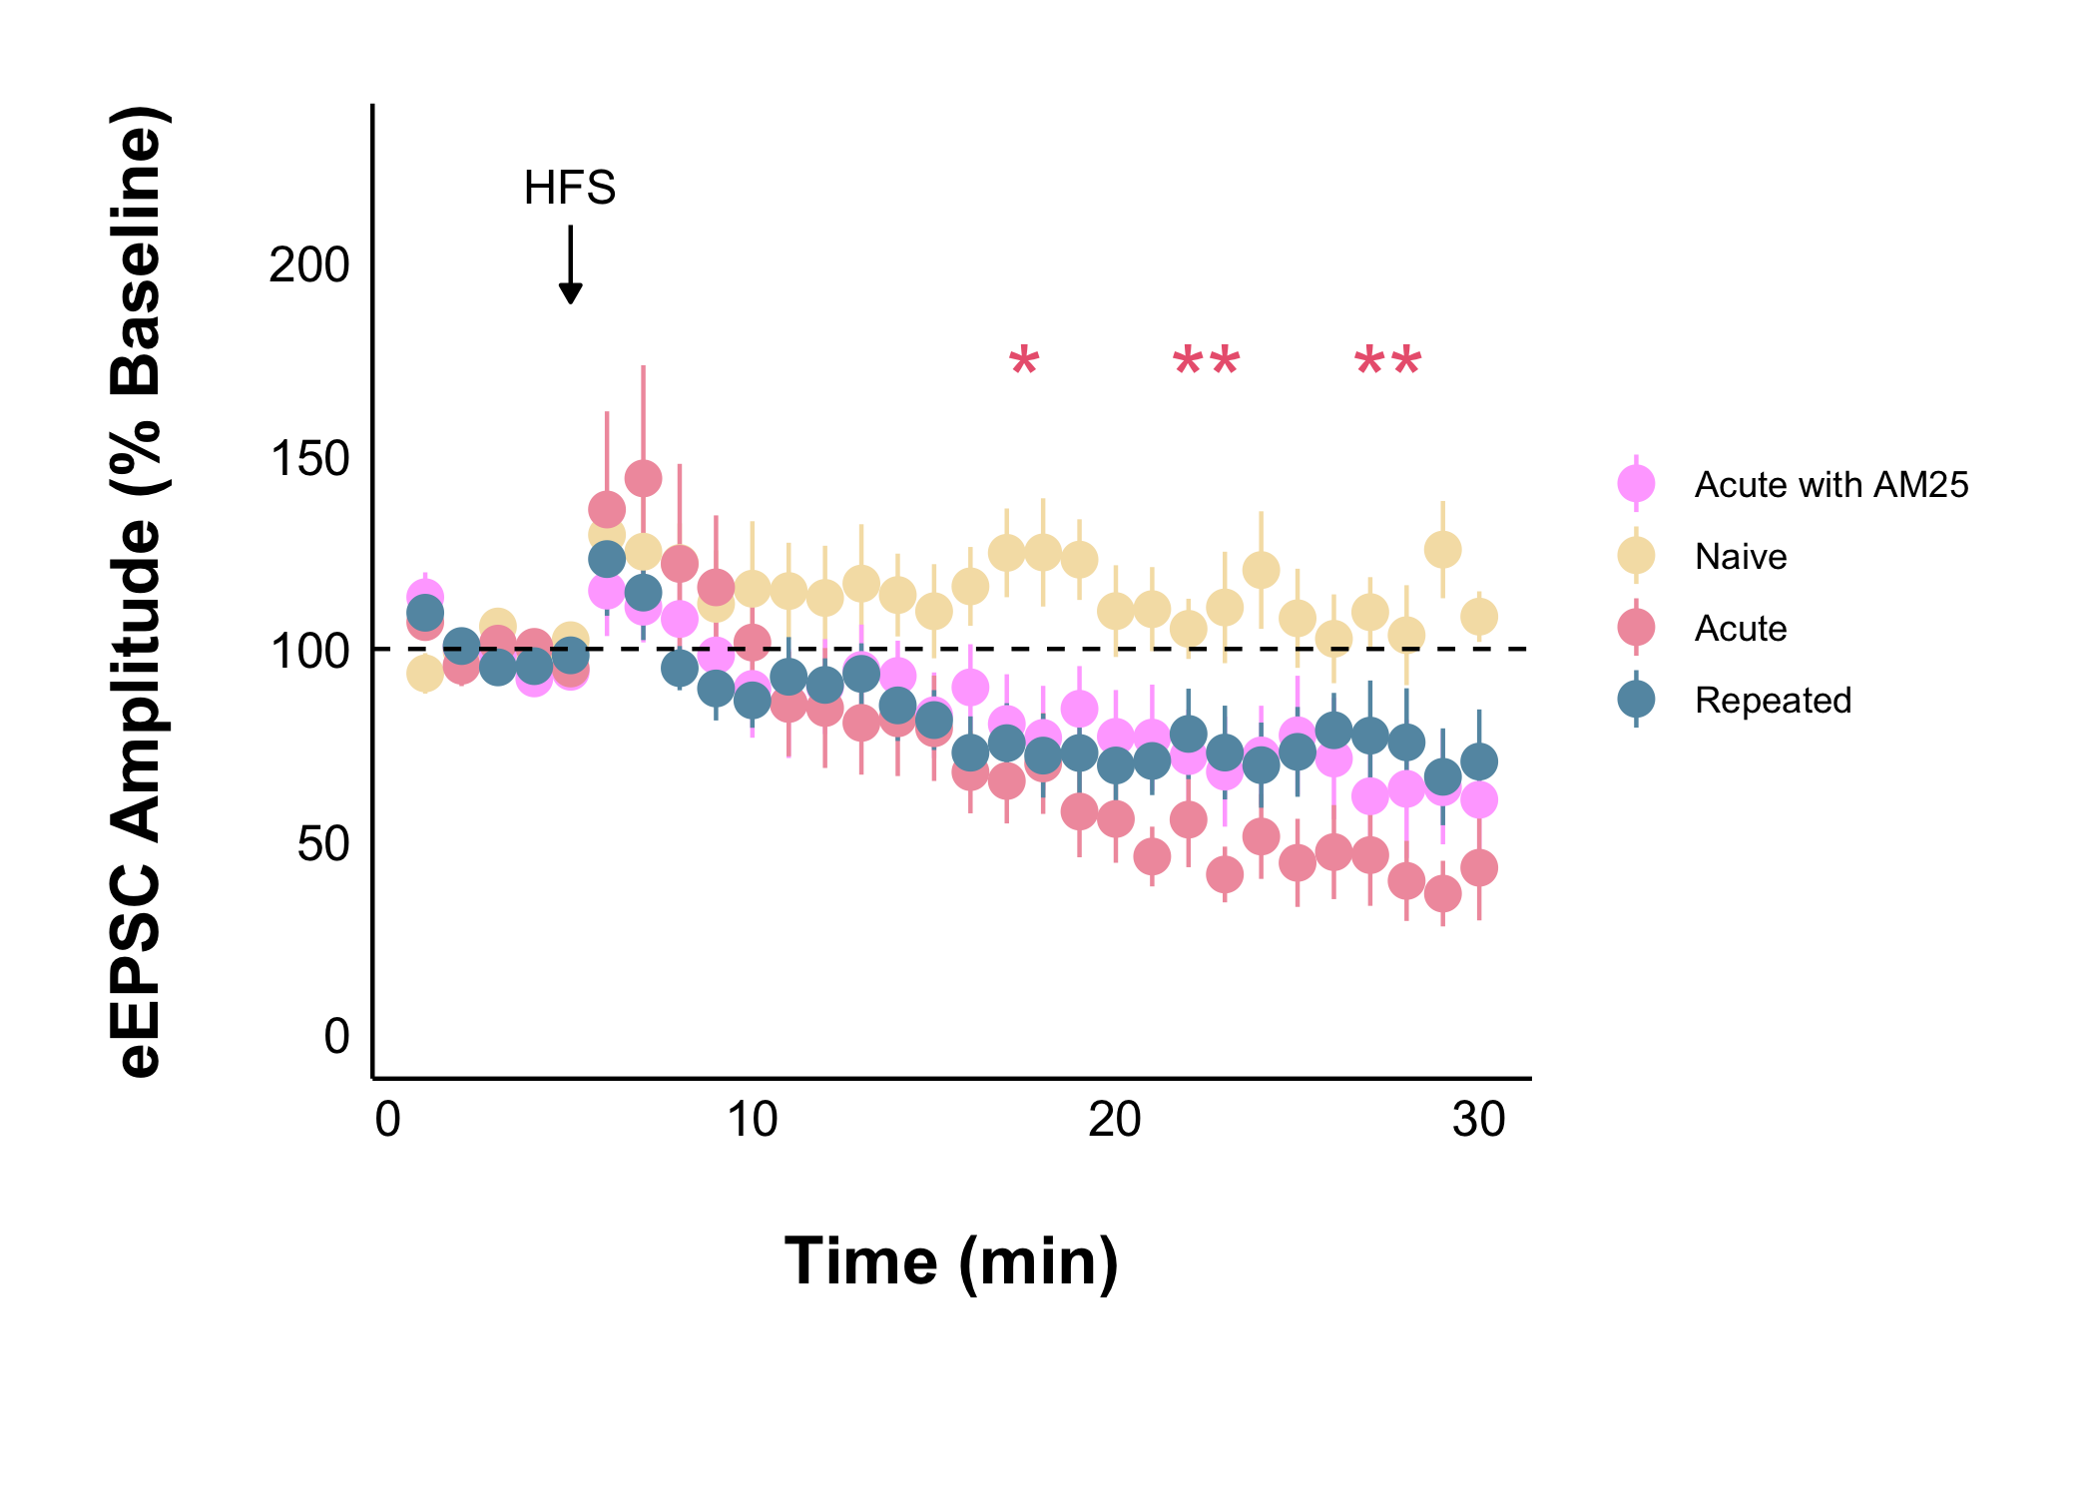
Summary of Current Data

Slide 45
Does acute stress and repeated stress affect the excitability of glutamatergic neurons in the DMH of young female rats?
* No naïve data yet *

Slide 46
100 mV
800 msec
Notes:
The current clamp steps protocol stimulates the cell for 500 milliseconds with current injections that increase in magnitude from -50 pA to 40 pA, 250 milliseconds between each step.

Slide 47
amplitude
threshold
100 mV
800 msec
Notes:
The current clamp steps protocol stimulates the cell for 500 milliseconds with current injections that increase in magnitude from -50 pA to 40 pA, 250 milliseconds between each step.

Slide 48
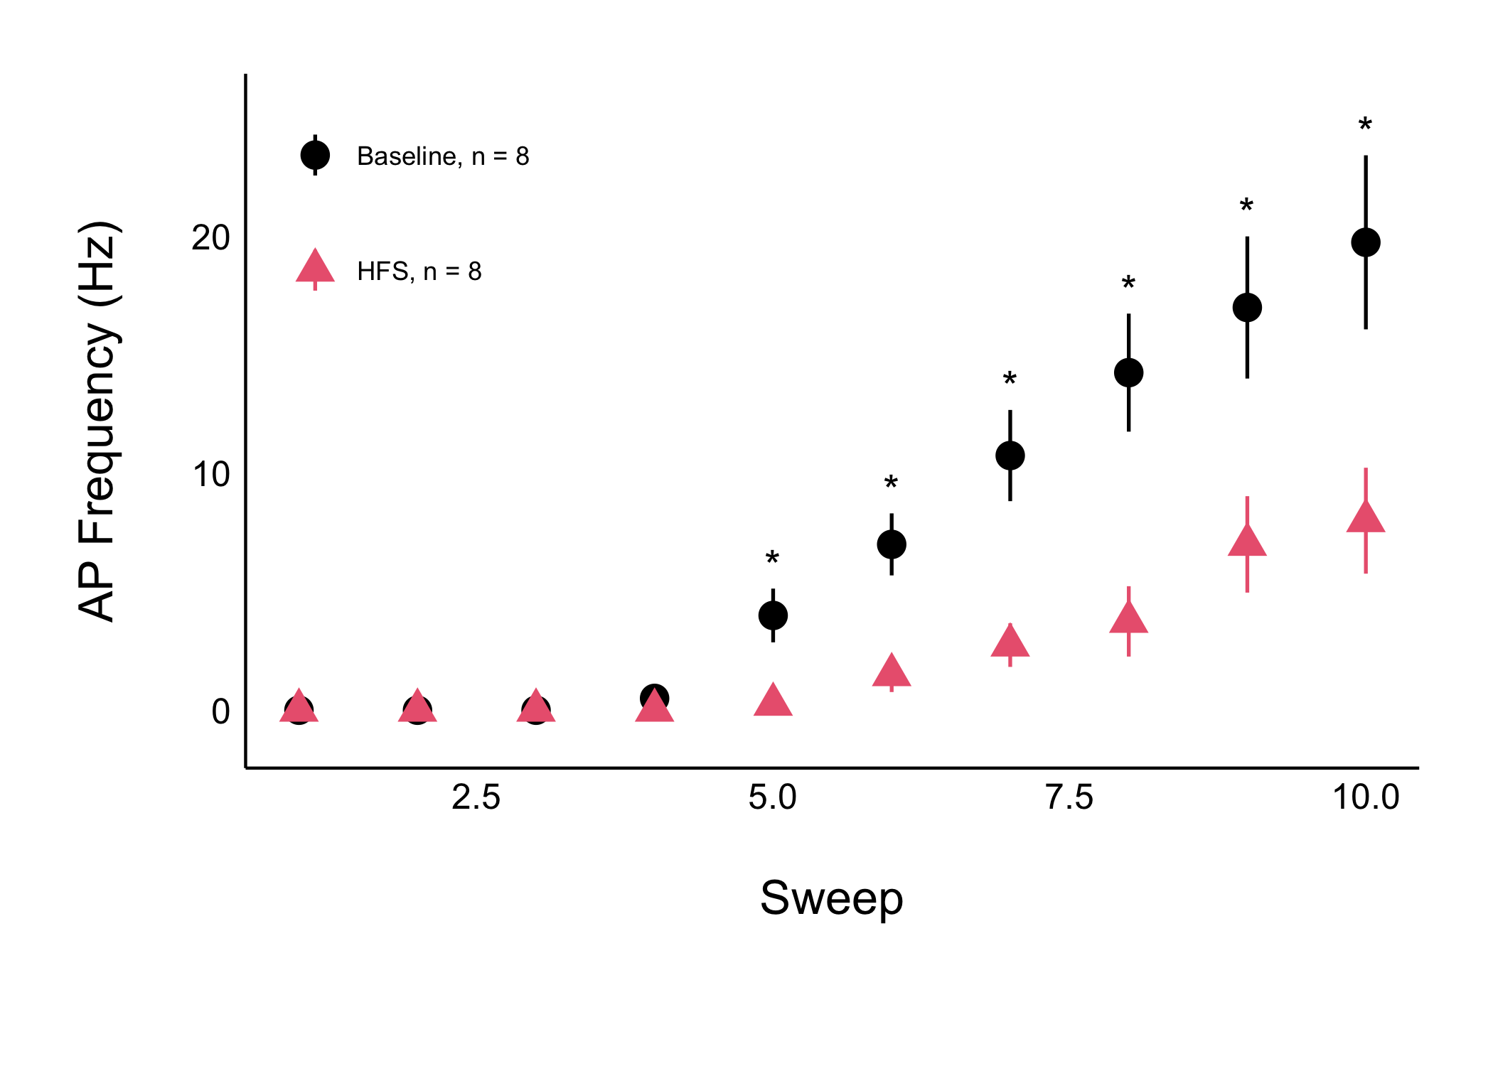
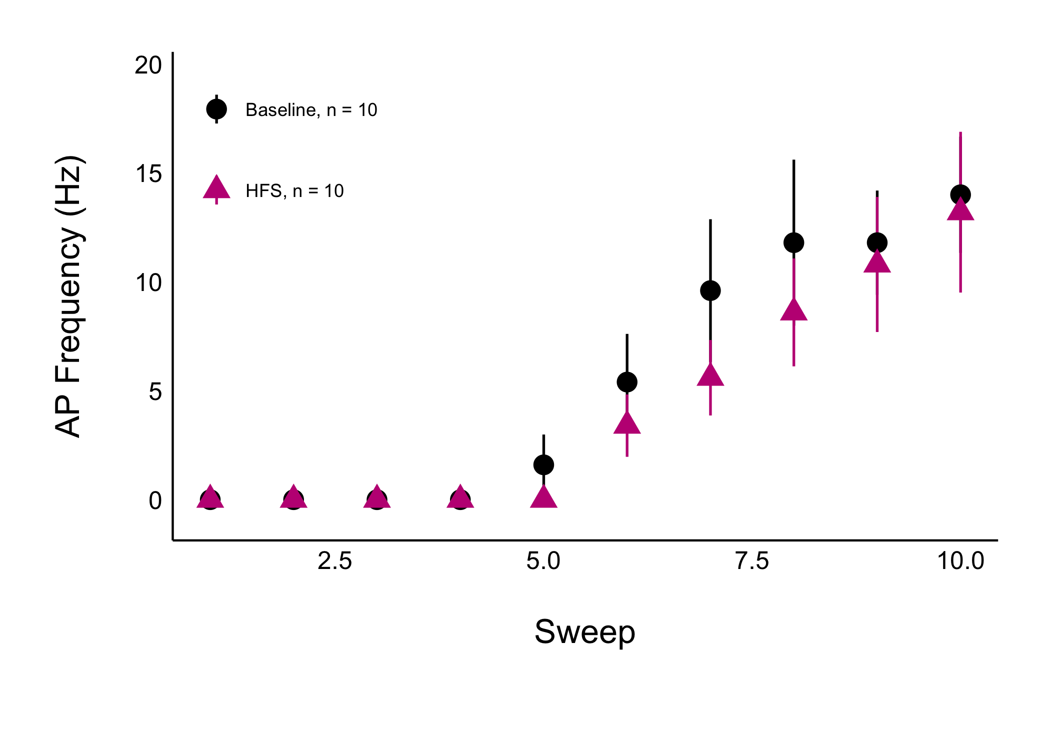
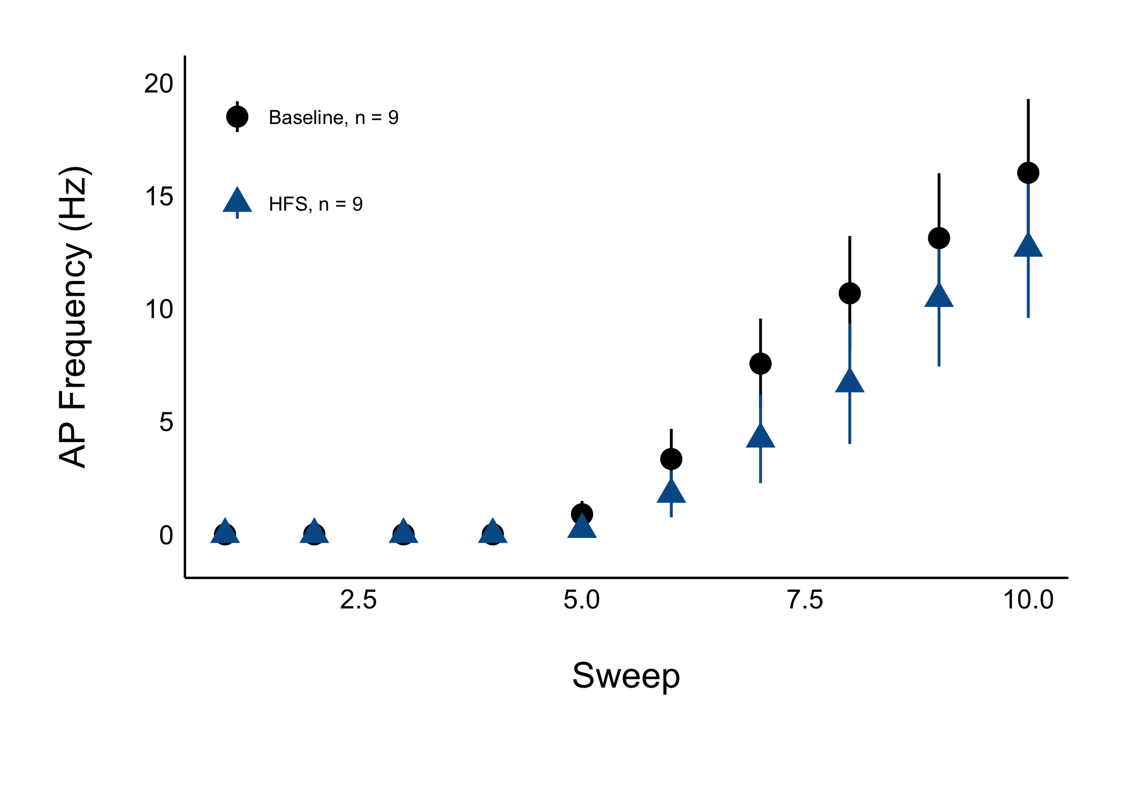
Acute stress decreases AP frequency in the long-term, but not when AM251 is used to block CB1 receptors
Long-term AP frequency does not change in repeated stress

Slide 49
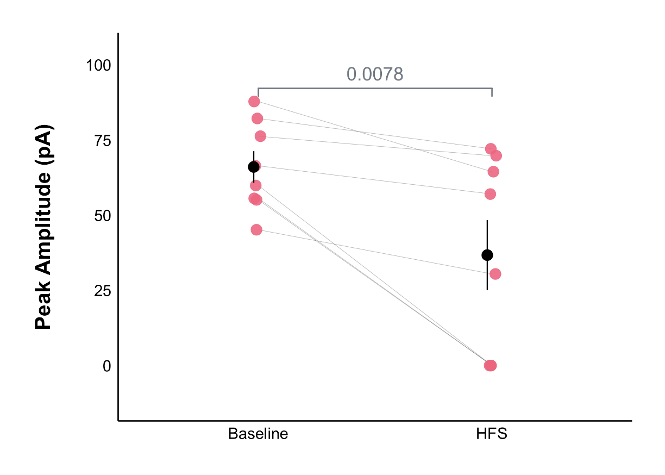
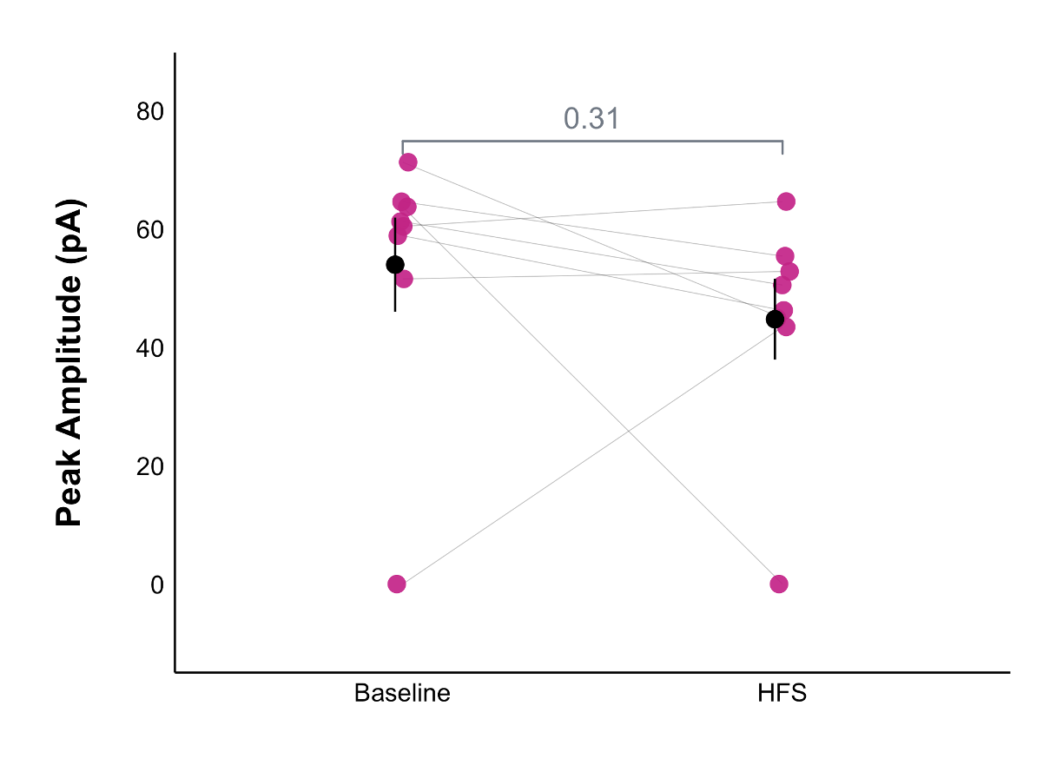
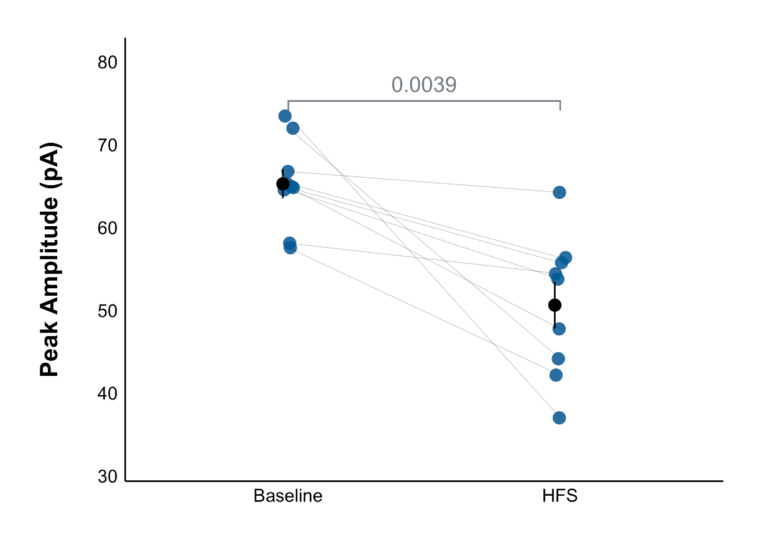
Acute stress decreases AP amplitude in the long-term, but not when AM251 is used to block CB1 receptors
Long-term AP amplitude decreases under repeated stress
* Need to remove the no action potentials from the AP amplitude

Slide 50
Conclusions
 | Acute | Acute with AM251 | Repeated
Baseline eEPSC amplitude | Increased | No change | No change
Baseline glutamate release | No change | No change | No change
Long-lasting eEPSC amplitude | Decreased | No change | No change
Long-lasting glutamate release | Decreased | No change | No change
Action potential frequency | Decreased | No change | No change
Action potential amplitude * | Decreased | No change | Decrease
* Need to remove the no action potentials from the AP amplitude

Slide 51
Conclusions
 | Acute | Acute with AM251 | Repeated
Baseline eEPSC amplitude | Increased | No change | No change
Baseline glutamate release | No change | No change | No change
Long-lasting eEPSC amplitude | Decreased | No change | No change
Long-lasting glutamate release | Decreased | No change | No change
Action potential frequency | Decreased | No change | No change
Action potential amplitude * | Decreased | No change | Decrease (?)
* Need to remove the no action potentials from the AP amplitude

Slide 52
Future Directions
Investigation of the role of corticosterone in the changes seen under acute stress via in vivo injection of 20 mg/kg mifepristone (or vehicle control) 30 minutes prior to stress
Timeline
Aiming for 2 cells/animal, for ~8 cells/group
Assuming 1 animal/week (minimum) starting in the Winter Term
Data collection should be done in February 2026
Data has been analyzed as it has been collected so actually getting results will not be an issue!

